Slide 1
Capstone Project-1
Air Booking Analysis
Team Members

Slide 2
Overview of Air booking Analysis:
Introduction
Abstract
Problem Statement
Exploratory Data Analysis
Steps Involved
Statistical Analysis
Conclusion

Slide 3
Introduction:

Slide 4
Abstract:

Slide 5
Problem Statement:

Slide 6
Exploratory Data Analysis:

Slide 7
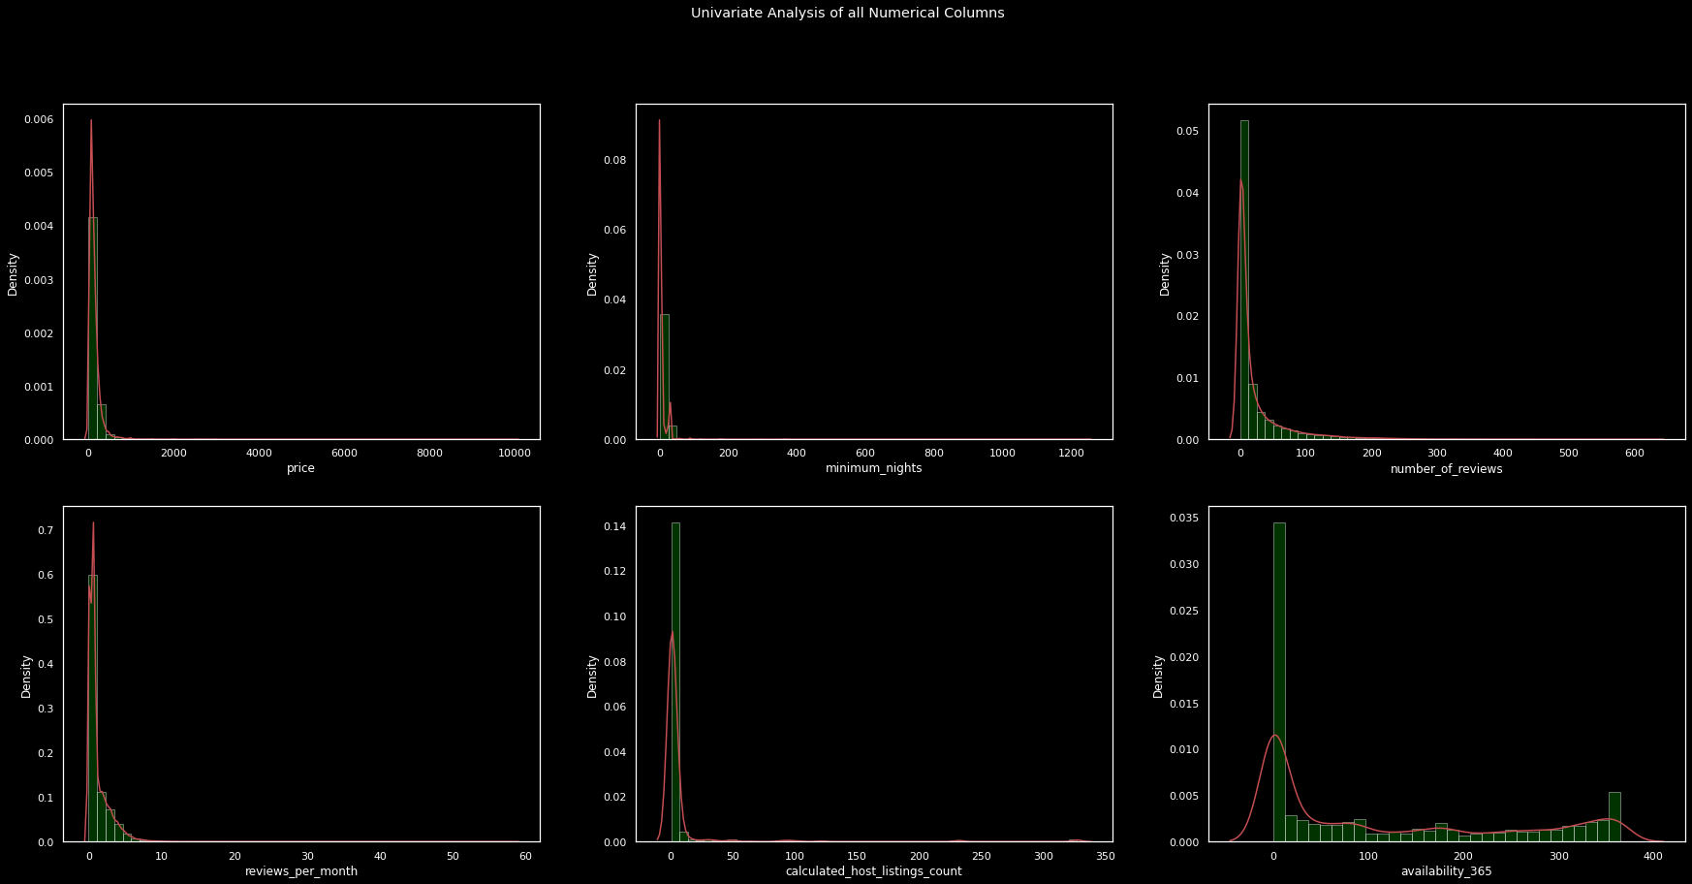
Univariate Analysis

Slide 8
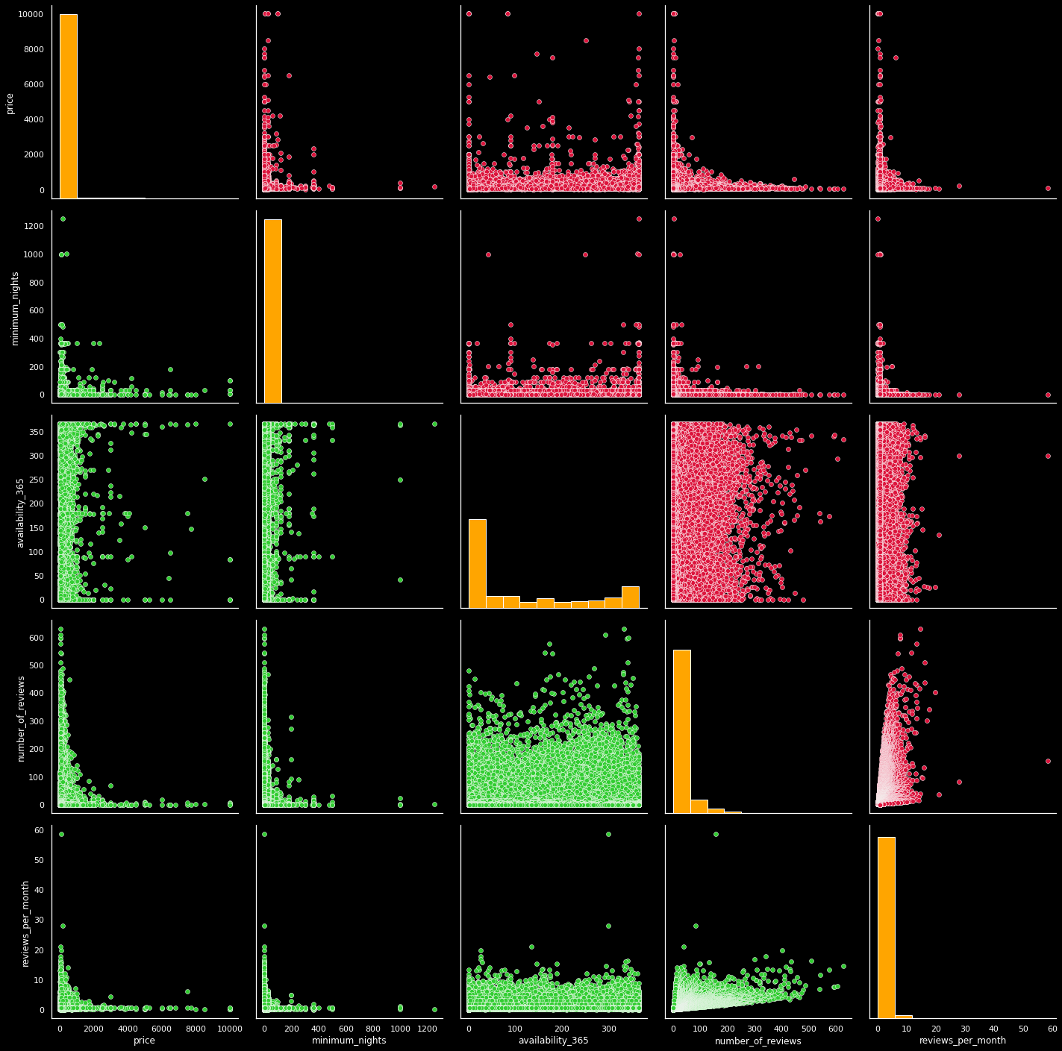
Bivariate Analysis

Slide 9
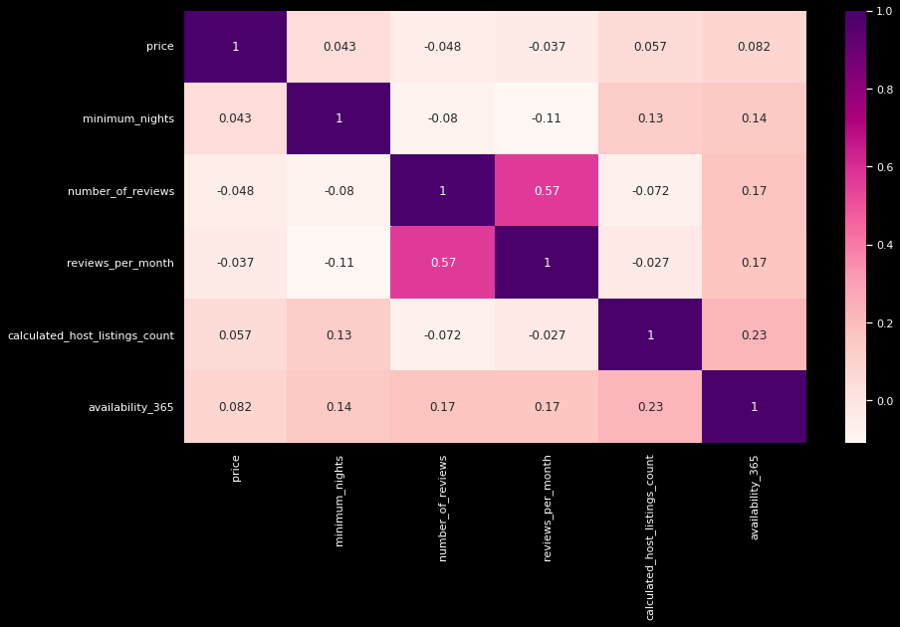
Correlation plot

Slide 10
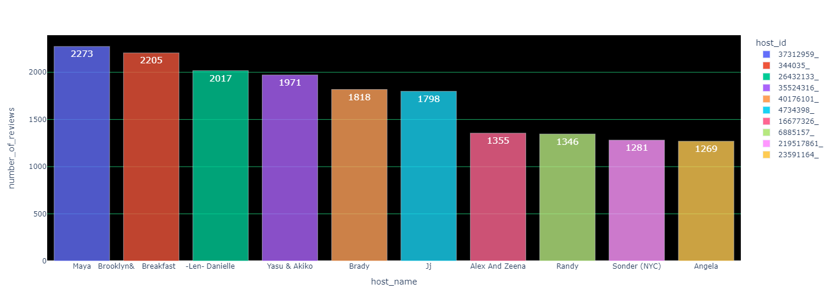
1st plot

Slide 11
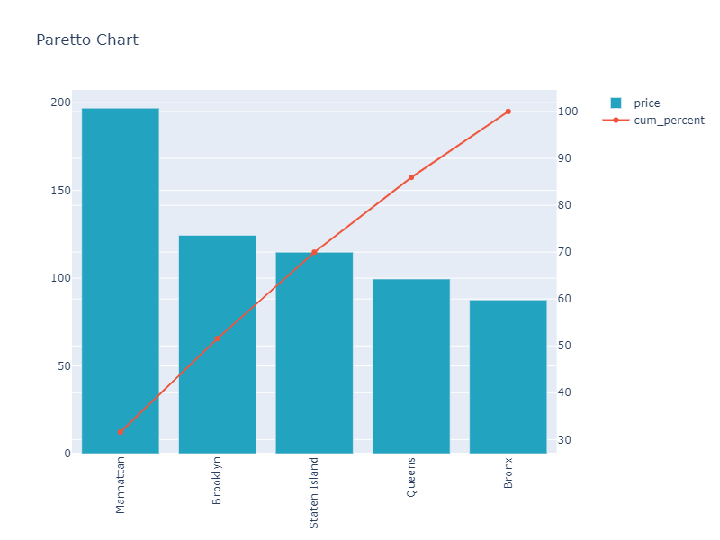
2nd plot

Slide 12
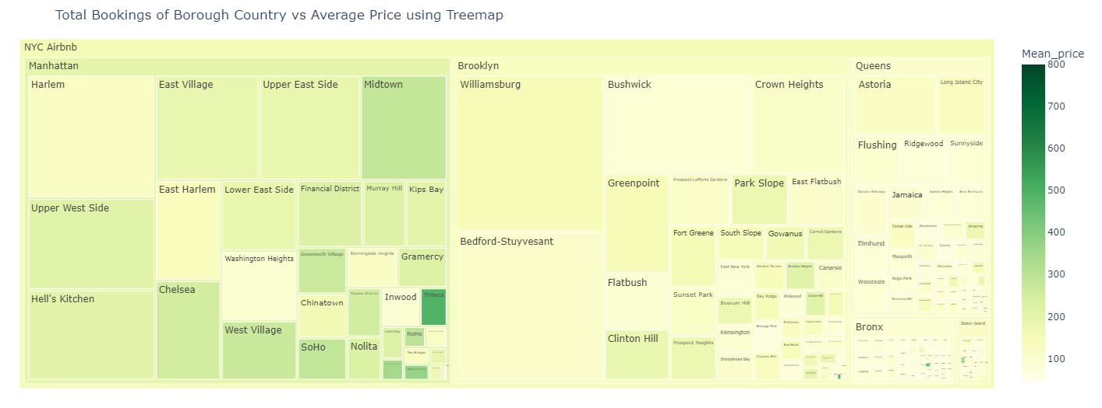
4th plot

Slide 13
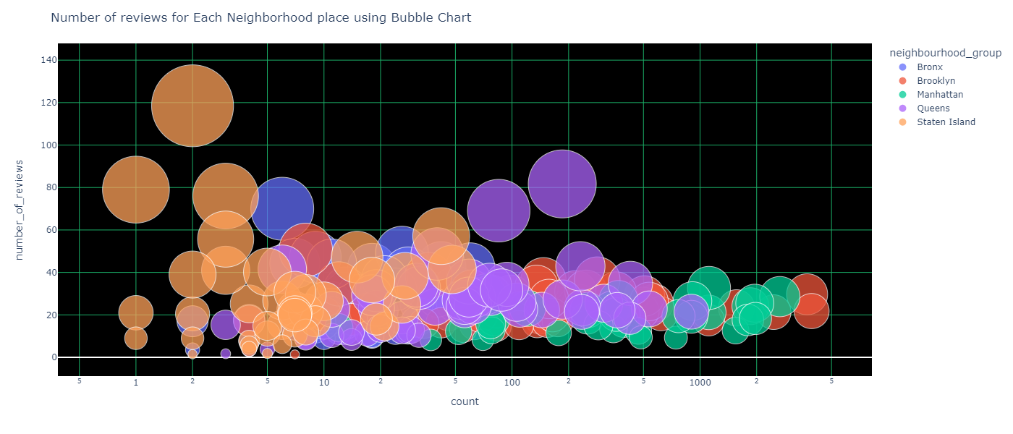
5thplot

Slide 14
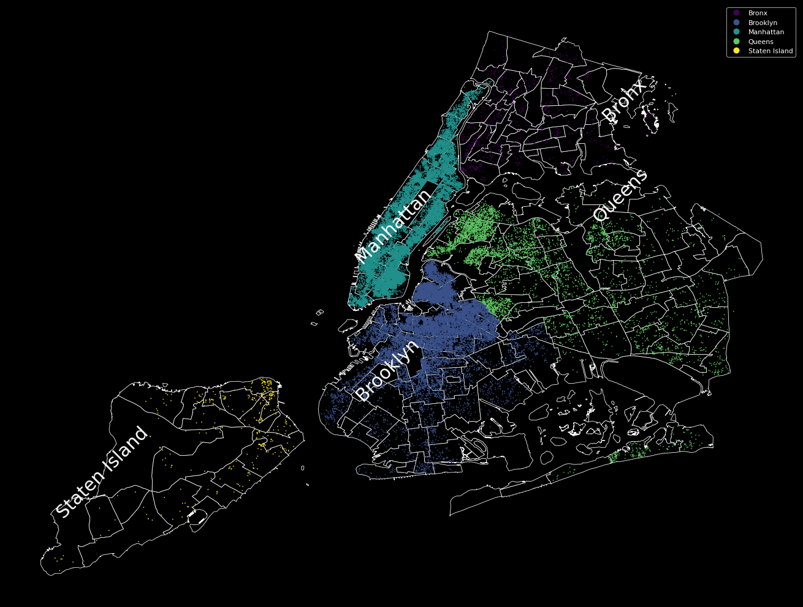
6th plot

Slide 15
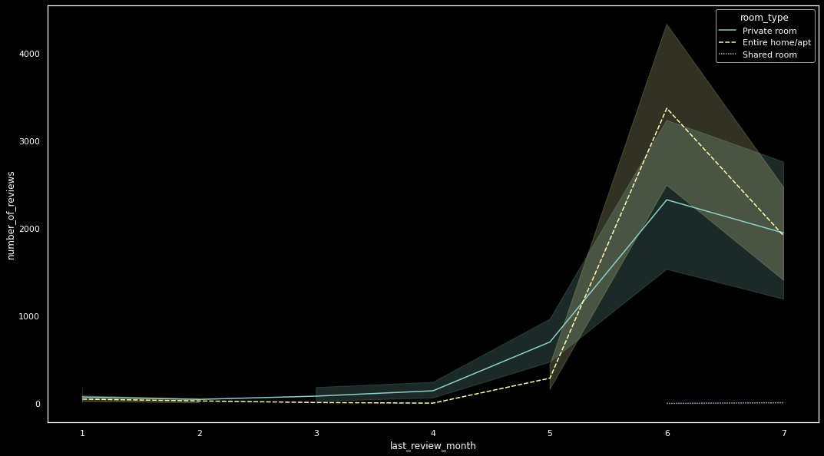
7th plot

Slide 16
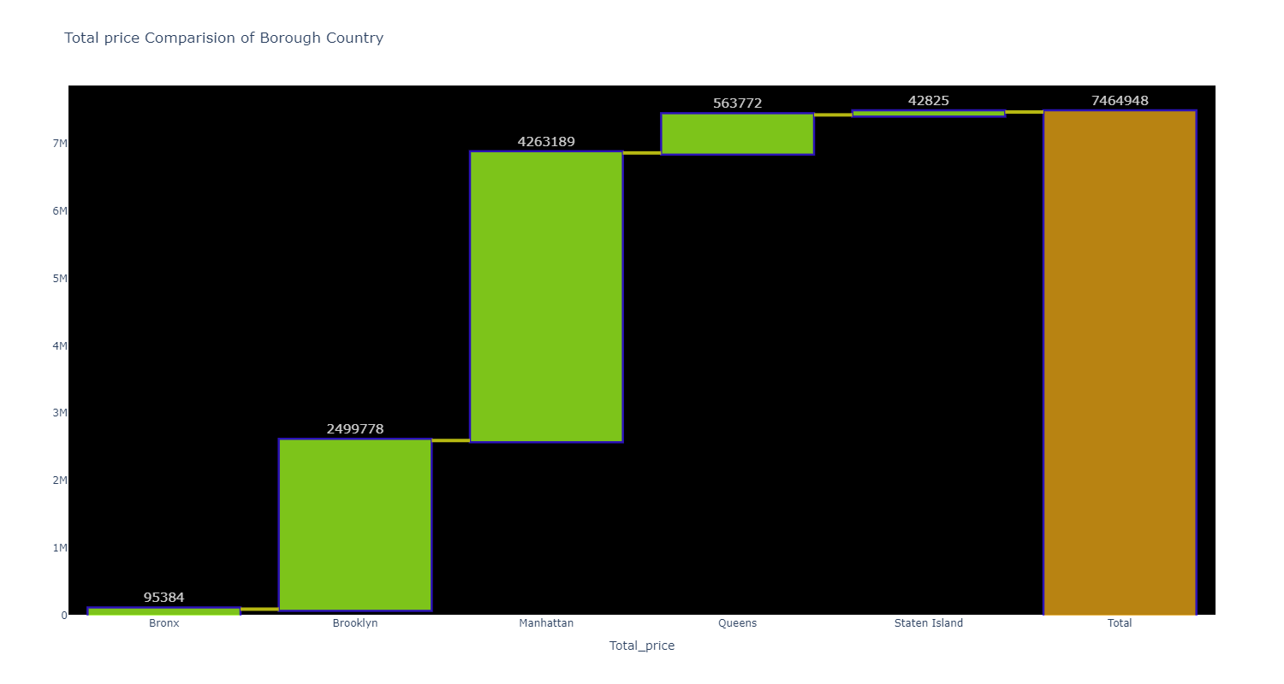
8th plot

Slide 17
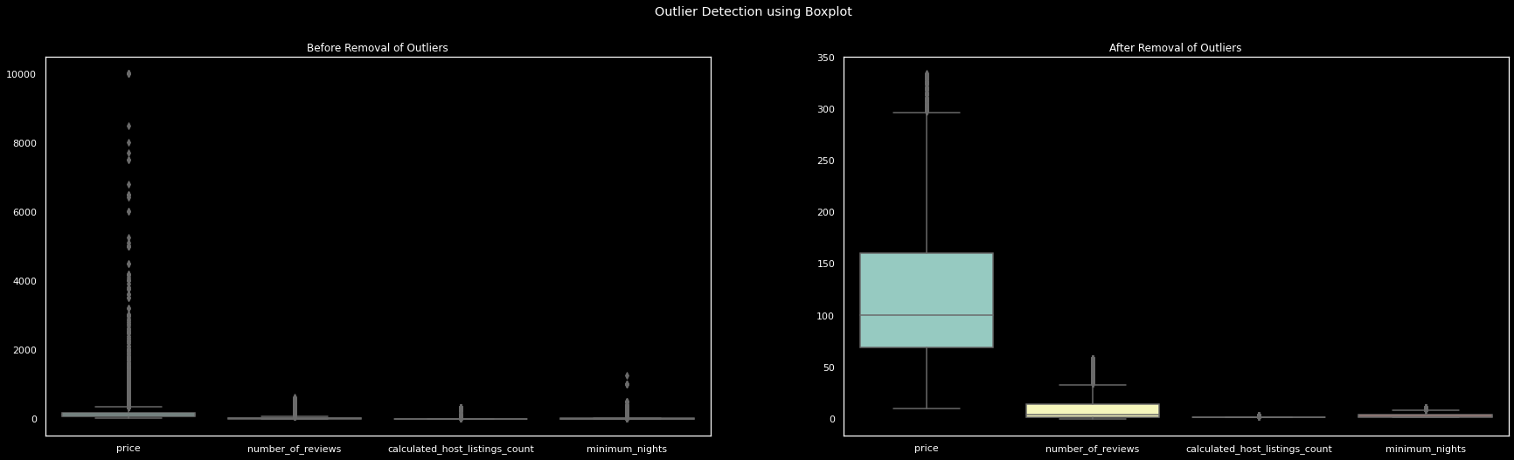
9th plot

Slide 18
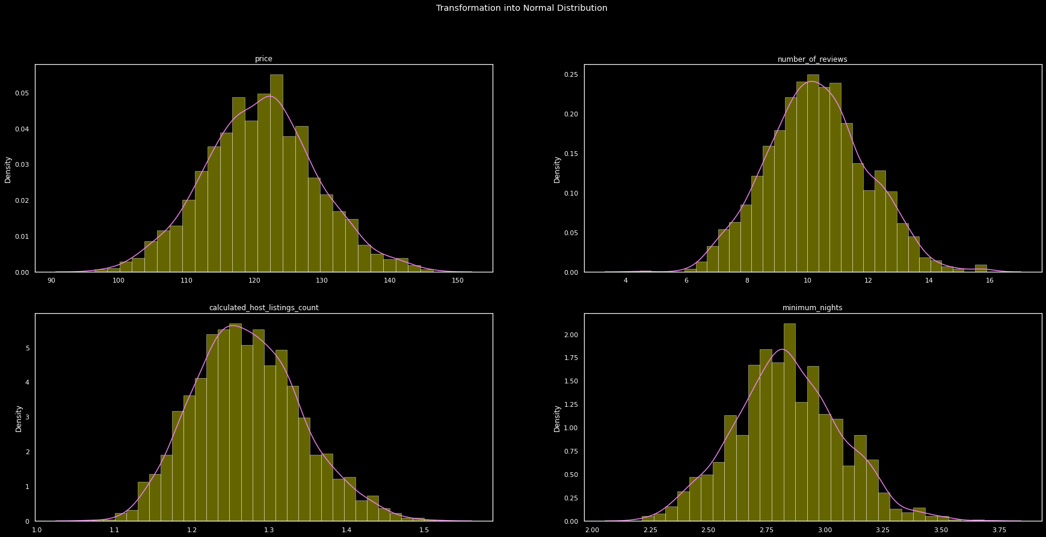
10th plot

Slide 19
Steps Involved:

Slide 20
Statistical Analysis:

Slide 21
Conclusion:

